Slide 1
Terrain Erosion in Voxels CGT 620 checkpoint 2
Yuanpei Zhao
zhao1023@purdue.edu

Slide 2
Solved Checkpoint 1 Problem
Water glitches and conservation of mass
Use 8 neighbors(instead of 4) for each water column
Use double precision(instead of float) to calculate
Revise boundary condition
Debug
Add Imgui for debugging

Slide 3
Expected Result of Checkpoint 2
Implement force-based erosion/deposition on GPU
Use ray-marching with refraction to render the terrain and water in OpenGL (finished at Checkpoint 1)
Outcome: A real-time terrain erosion/deposition simulation with fixed water initial state and rendering

Slide 4
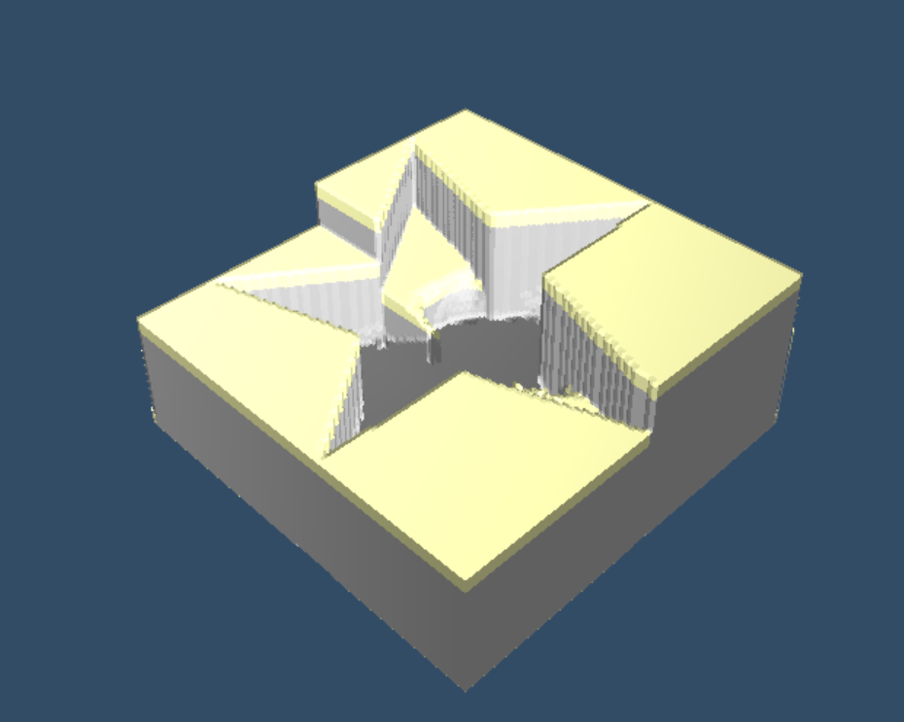
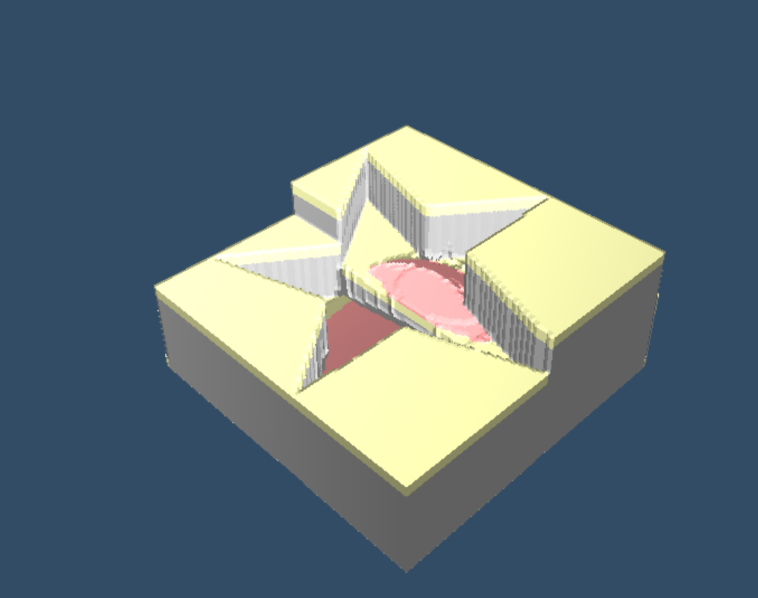
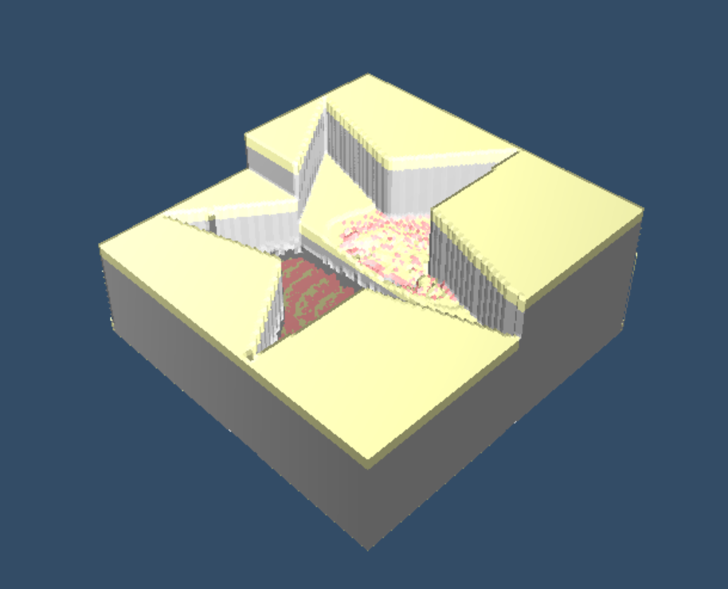
3 Steps
Erosion
Deposition
Mass Transfer

Slide 5

Erosion
Define m as amount of mass per terrain voxel
At first $m=1.0$
When water running over, $m−=erosionRate$
If $m <= 0.0$, terrain voxel transfer to water

Slide 6

Deposition
When erosion happens, the mass contained in water mWater increases
Define equilibrium sediment mass $c=\min\left(k\left\|u\right\|,c_{max}\right)$
If $c≤mWater$, the bottom voxel of water column transfer back to terrain material

Slide 7

Mass Transfer
Need to solve advection equation:
$\frac{∂mass}{∂t}=−\left(u∙∇\right)mass$
Maybe semi-Lagrangian MacCormack method(Selle et. Al, 2007)
But just a simple transfer model for now

Slide 8

Mass Transfer
Assume that mass is evenly distributed in each water column
Observe flow exchange $f$ from one column to each of its neighbors
If $f<0$, outflow, $m_{n+1}−=m_{n}∗(h_{outflow}/h_{total})$
If $f>0$, inflow, $m_{n+1}+=m_{n}^{neighbor}∗ (h_{outflow}/h_{total})$

Slide 9
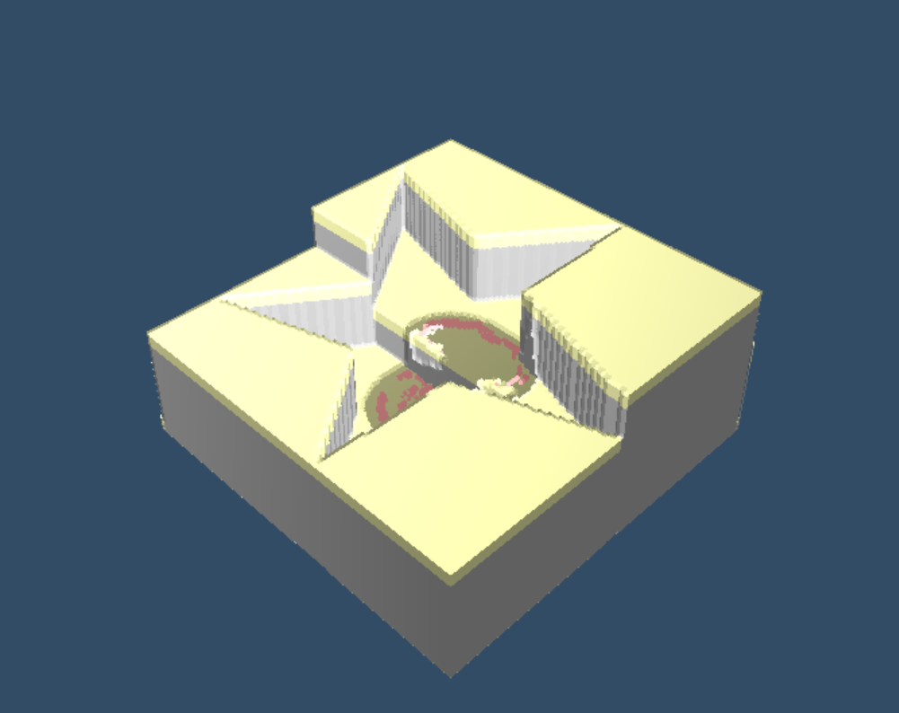
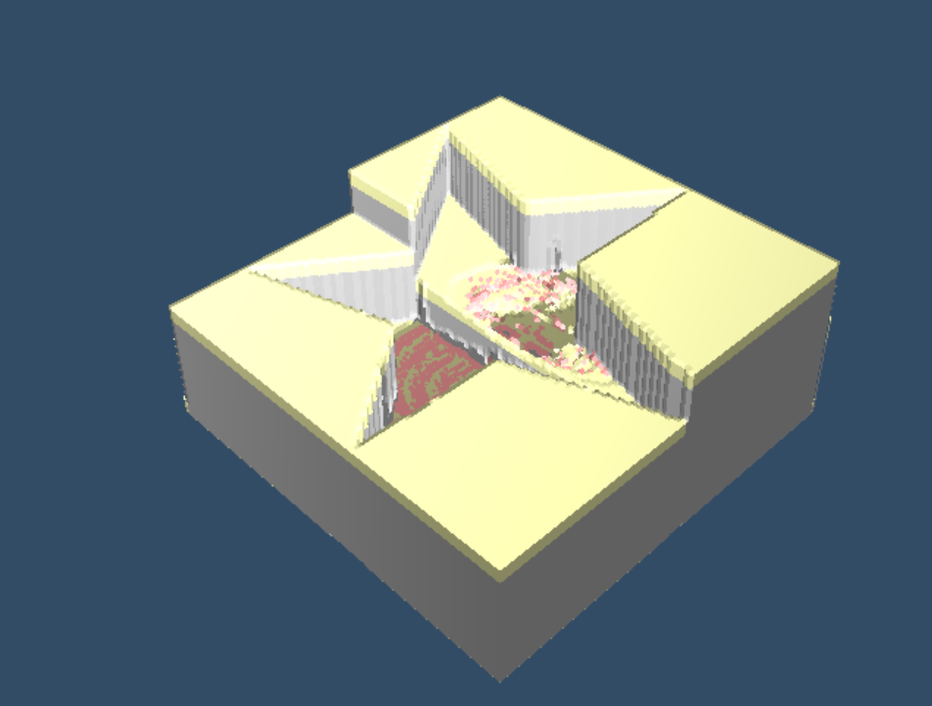
Outcome
A real-time terrain erosion/deposition simulation with fixed water initial state and rendering
Problem to be solved: Water Leaking

